Slide 1
Superconducting Qubit Program
Project #11
Tilock Sadhukhan, Indranil Ghosh, Achyut Chebiyam, Kazim Mumtaz, Aniekan Afangideh

Slide 2
OVERVIEW
Transmon qubits are a type of superconducting qubit that enhance coherence times by minimizing sensitivity to charge noise through the introduction of a larger shunting capacitance.
They are fundamental components in quantum computing, enabling the development of scalable quantum processors.

Slide 3
OBJECTIVE
To explore the simulation of transmon qubits, focusing on their mathematical modeling, energy spectrum analysis, and the impact of noise on their behavior.

Slide 4
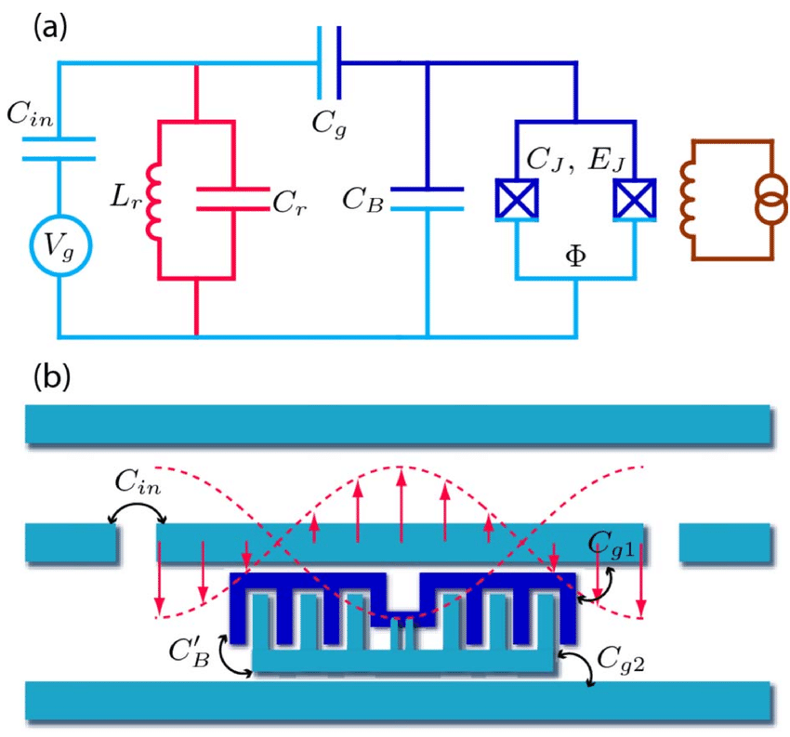
What is a Transmon Qubit?
A transmon qubit is a type of superconducting qubit designed to reduce sensitivity to charge noise, thereby enhancing coherence times.
Applications
Widely utilized in quantum computing for their scalability and improved coherence properties.

Slide 5





Mathematical Model of Transmon Qubits
The transmon qubit is described by the Hamiltonian:
where:
Charging energy Josephson energy
Number operator (number of Cooper pairs) Offset charge
Phase difference across the Josephson junction
Energy Levels:
The energy levels of a transmon qubit are anharmonic, meaning the spacing between consecutive energy levels decreases with increasing energy. This anharmonicity allows for the differentiation between the qubit states |0> and |1>, facilitating quantum operations.

Slide 6
Simulation Objectives
Purpose
To model the behavior of transmon qubits and analyze their energy spectra.
To understand the impact of noise on transmon qubits and their coherence properties.
Tools
Utilize Python libraries such as NumPy and Matplotlib for numerical computations and visualization.
Implement simulations to study the dynamics and stability of transmon qubits under various conditions.

Slide 7
Defining the Transmon Hamiltonian in Python
Objective:
To construct the Hamiltonian matrix for a transmon qubit using Python, facilitating the analysis of its energy levels and dynamics.
Code Implementation:
The Hamiltonian can be represented in the charge basis
import numpy as np
def define_transmon_hamiltonian(num_levels=4, E_C=0.2, E_J=1.0):
n = np.arange(-num_levels // 2, num_levels // 2)
H = np.diag(4 * E_C * (n**2))
for i in range(len(n) - 1):
H[i, i + 1] = H[i + 1, i] = -E_J / 2
return H

Slide 8
Computing Energy Levels
Objective:
To determine the energy eigenvalues and eigenvectors of the transmon qubit's Hamiltonian, which are essential for understanding its quantum behavior.
Code Implementation:
Utilize NumPy's `linalg.eigh` function to compute the eigenvalues and eigenvectors of the Hamiltonian matrix:
import numpy as np
def compute_energy_levels(H):
eigenvalues, eigenvectors = np.linalg.eigh(H)
return eigenvalues, eigenvectors

Slide 9
Visualizing the Energy Spectrum
Objective:
To graphically represent the energy levels of the transmon qubit, facilitating a clear understanding of its quantum states.
Code Implementation:
Utilize Matplotlib to plot the computed energy levels:
import matplotlib.pyplot as plt
def plot_energy_spectrum(eigenvalues):
plt.plot(eigenvalues, 'o', label="Energy Levels")
plt.xlabel('State Index')
plt.ylabel('Energy Level (in arbitrary units)')
plt.title('Energy Spectrum of the Transmon System')
plt.grid(True)
plt.legend()
plt.show()

Slide 10
Simulating Noise in the Transmon Hamiltonian
To understand how external noise affects the transmon qubit's energy levels and coherence properties.
Methodology:
Introduce random perturbations to the Hamiltonian matrix to simulate environmental noise and ensure the perturbed Hamiltonian remains Hermitian to represent a physical quantum system accurately.
Code Implementation:
import numpy as np
def add_noise_to_hamiltonian(H, noise_level=0.01):
"""
Introduce random noise to the Hamiltonian to simulate experimental imperfections.
"""
noise = noise_level * np.random.randn(*H.shape)
noisy_H = H + (noise + noise.T) / 2 # Ensure Hermiticity
return noisy_H

Slide 11
Analyzing the Impact of Noise on Energy Levels
Objective: To assess how environmental noise influences the energy spectrum of the transmon qubit.
Methodology:
- Compute the eigenvalues of both the original and noisy Hamiltonians.
- Compare the energy levels to identify shifts or perturbations caused by noise.

Slide 12
Code Implementation:
Utilize previously defined functions to compute and plot energy levels:
# Compute eigenvalues for the original Hamiltonian
eigenvalues, _ = compute_energy_levels(transmon_H)
# Compute eigenvalues for the noisy Hamiltonian
noisy_H = add_noise_to_hamiltonian(transmon_H)
noisy_eigenvalues, _ = compute_energy_levels(noisy_H)
# Plot both spectra for comparison
plt.plot(eigenvalues, 'o', label="Original Energy Levels")
plt.plot(noisy_eigenvalues, 'x', label="Noisy Energy Levels")
plt.xlabel('State Index')
plt.ylabel('Energy Level (in arbitrary units)')
plt.title('Comparison of Energy Spectra')
plt.grid(True)
plt.legend()
plt.show()

Slide 13
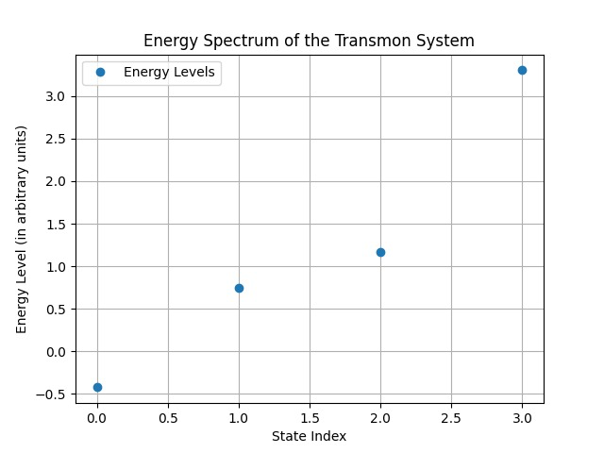
Results
As visible in the graph to the left, there are discrete energy levels measured for each state index.
We have successfully simulated the energy spectrum of 2 superconducting transmons

Slide 14
Thank you

